Slide 1
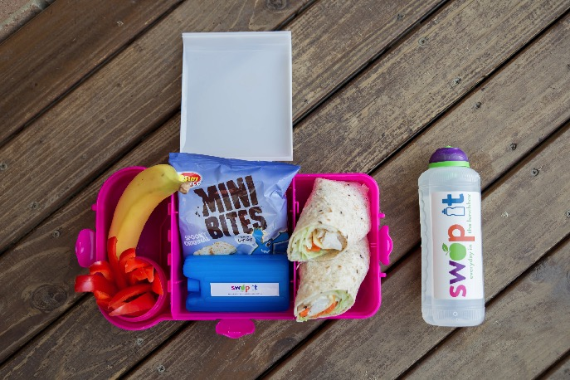
Artwork: ‘Heart of a child’ by Lara Went, Worimi Artist
Notes:
TEACHER NOTES
a. Draw attention to each item packed in the picture
b. Ask who has each item packed in their lunchbox
c. What do they like about it? Prompt for taste, texture and smell
d. Ask who thinks they will have each item in their lunchbox this week
What you might like to say if children give the following responses:
- “That’s yuck/gross/disgusting”
RESPONSE ideas -
• Everyone likes different things and it’s ok to be different. Sometimes people don’t like one type of food for a long time and then suddenly like it!
• Do you know what the food is?
• Have you tried this food before?
• Would you try the food if your friend was eating it/sports person?
• Would you try the food if it was cut into smaller pieces?
• Would you try the food if you were really hungry/time of the day?
TEACHER’S RESOURCE
http://abgc.org.au/banana-industry-2/our-industry/key-facts/
https://australianbananas.com.au/Pages/all-about-bananas/production
From the time of planting it usually takes 12 months or so to produce the first bunch of bananas. After that, bunches come every 8-10 months. A bunch averages 150 to 200 bananas and weighs approximately 35-50 kilograms.
When the bunch is harvested, the parent or mother plants trunk is cut through at about head height. The section of trunk that’s left standing nourishes the young ‘sucker’ plants that grow at its base.
These plants go on to produce their own bunches. The top part of the mother plants trunk becomes organic plantation matter.
Whilst brands may be depicted in these images, Good For Kids has no affiliation and do not endorse any specific food brand. We do not warrant that the information we provide will meet individual health, nutritional or medical requirements,
or individual school policy. For more lunchbox suggestions see www.goodforkids.nsw.gov.au.

Slide 2
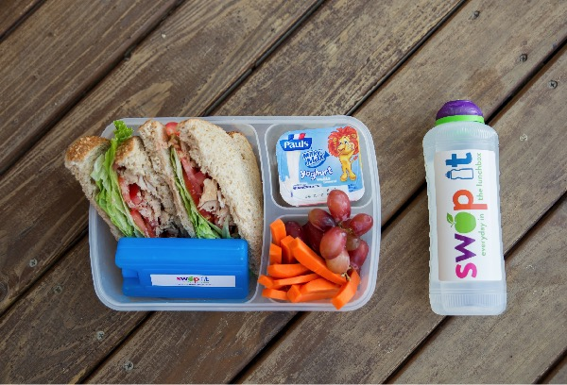
Artwork: ‘Heart of a child’ by Lara Went, Worimi Artist
Notes:
TEACHER NOTES
a. Draw attention to each item packed in the picture
b. Ask who has each item packed in their lunchbox
c. What do they like about it? Prompt for taste, texture and smell
d. Ask who thinks they will have each item in their lunchbox this week
What you might like to say if children give the following responses:
- “That’s yuck/gross/disgusting”
RESPONSE ideas -
• Everyone likes different things and it’s ok to be different. Sometimes people don’t like one type of food for a long time and then suddenly like it!
• Do you know what the food is?
• Have you tried this food before?
• Would you try the food if your friend was eating it/sports person?
• Would you try the food if it was cut into smaller pieces?
• Would you try the food if you were really hungry/time of the day?
TEACHER’S RESOURCE
https://healthy-kids.com.au/food-nutrition/nutrients-in-food/calcium/
(cheese, milk, custard, leafy green vegetables like broccoli and spinach)
Whilst brands may be depicted in these images, Good For Kids has no affiliation and do not endorse any specific food brand. We do not warrant that the information we provide will meet individual health, nutritional or medical requirements,
or individual school policy. For more lunchbox suggestions see www.goodforkids.nsw.gov.au.

Slide 3
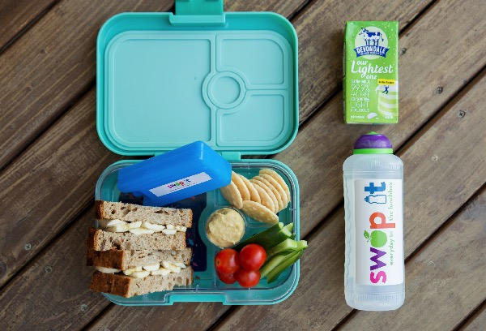
Artwork: ‘Heart of a child’ by Lara Went, Worimi Artist
Notes:
TEACHER NOTES
a. Draw attention to each item packed in the picture
b. Ask who has each item packed in their lunchbox
c. What do they like about it? Prompt for taste, texture and smell
d. Ask who thinks they will have each item in their lunchbox this week
What you might like to say if children give the following responses:
- “That’s yuck/gross/disgusting”
RESPONSE ideas -
• Everyone likes different things and it’s ok to be different. Sometimes people don’t like one type of food for a long time and then suddenly like it!
• Do you know what the food is?
• Have you tried this food before?
• Would you try the food if your friend was eating it/sports person?
• Would you try the food if it was cut into smaller pieces?
• Would you try the food if you were really hungry/time of the day?
TEACHER’S RESOURCE
http://www.rrtcadd.org/resources/Advocacy/Water-Amounts-in-Fruits-and-Vegetables---Handout-Week-10.pdf
(lettuce, zucchini, radish, celery, tomato and cabbage are all above 90%)
Whilst brands may be depicted in these images, Good For Kids has no affiliation and do not endorse any specific food brand. We do not warrant that the information we provide will meet individual health, nutritional or medical requirements,
or individual school policy. For more lunchbox suggestions see www.goodforkids.nsw.gov.au.

Slide 4
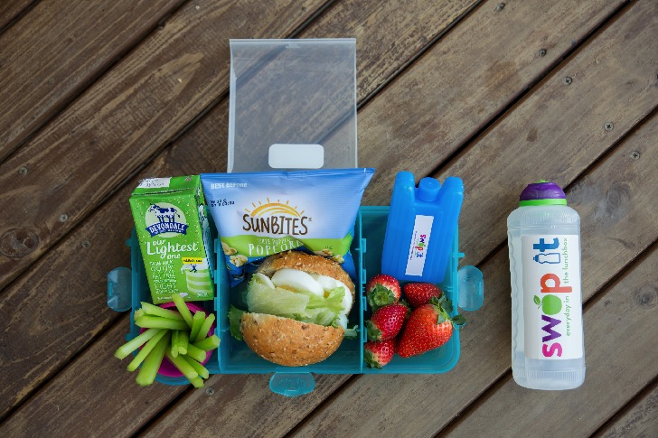
Artwork: ‘Heart of a child’ by Lara Went, Worimi Artist
Notes:
TEACHER NOTES
a. Draw attention to each item packed in the picture
b. Ask who has each item packed in their lunchbox
c. What do they like about it? Prompt for taste, texture and smell
d. Ask who thinks they will have each item in their lunchbox this week
What you might like to say if children give the following responses:
- “That’s yuck/gross/disgusting”
RESPONSE ideas -
• Everyone likes different things and it’s ok to be different. Sometimes people don’t like one type of food for a long time and then suddenly like it!
• Do you know what the food is?
• Have you tried this food before?
• Would you try the food if your friend was eating it/sports person?
• Would you try the food if it was cut into smaller pieces?
• Would you try the food if you were really hungry/time of the day?
TEACHER’S RESOURCE
• (butter, salt, caramel etc)
• The more fat (butter/oil/margarine) and sugar (caramel/honey/chocolate) you add the less
healthy popcorn becomes. Imagine if you put chocolate on a carrot – is it still an everyday food?
• Popcorn with the least added flavours is the healthiest, everyday option.
Whilst brands may be depicted in these images, Good For Kids has no affiliation and do not endorse any specific food brand. We do not warrant that the information we provide will meet individual health, nutritional or medical requirements,
or individual school policy. For more lunchbox suggestions see www.goodforkids.nsw.gov.au.

Slide 5
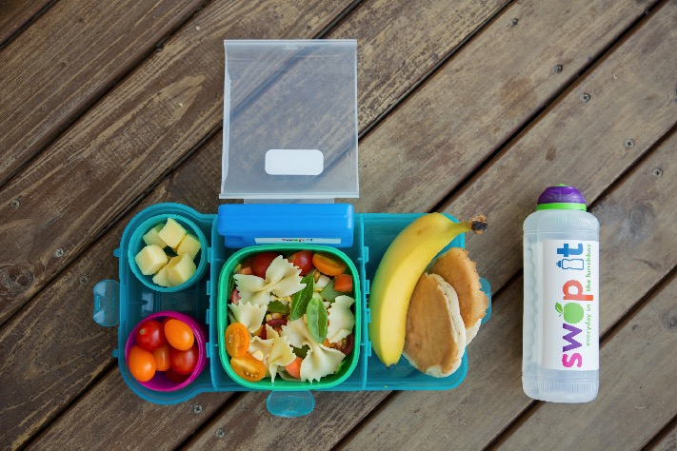
Artwork: ‘Heart of a child’ by Lara Went, Worimi Artist
Notes:
TEACHER NOTES
a. Draw attention to each item packed in the picture
b. Ask who has each item packed in their lunchbox
c. What do they like about it? Prompt for taste, texture and smell
d. Ask who thinks they will have each item in their lunchbox this week
What you might like to say if children give the following responses:
- “That’s yuck/gross/disgusting”
RESPONSE ideas -
• Everyone likes different things and it’s ok to be different. Sometimes people don’t like one type of food for a long time and then suddenly like it!
• Do you know what the food is?
• Have you tried this food before?
• Would you try the food if your friend was eating it/sports person?
• Would you try the food if it was cut into smaller pieces?
• Would you try the food if you were really hungry/time of the day?
TEACHER’S RESOURCE
Dictionary definition of a fruit: ‘the sweet and fleshy product of a tree or other plant that contains seeds and can be eaten as a fruit’. So because a tomato contains seeds, it is classed
as a fruit.
Other vegetables that are actually fruits include: capsicums, pumpkins, cucumbers, eggplant, zucchini, pea pods, green beans, olives, corn and avocado. Even though these foods are technically fruits we eat them as a vegetable.
Whilst brands may be depicted in these images, Good For Kids has no affiliation and do not endorse any specific food brand. We do not warrant that the information we provide will meet individual health, nutritional or medical requirements,
or individual school policy. For more lunchbox suggestions see www.goodforkids.nsw.gov.au.

Slide 6
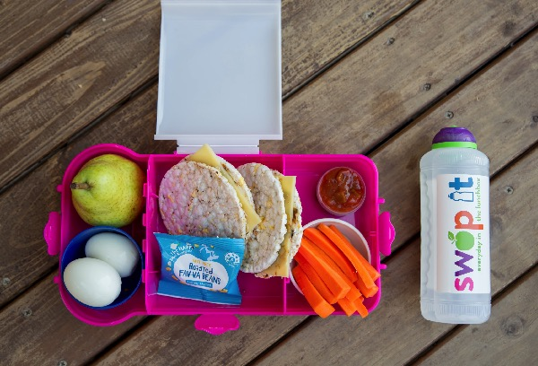
Artwork: ‘Heart of a child’ by Lara Went, Worimi Artist
Notes:
TEACHER NOTES
a. Draw attention to each item packed in the picture
b. Ask who has each item packed in their lunchbox
c. What do they like about it? Prompt for taste, texture and smell
d. Ask who thinks they will have each item in their lunchbox this week
What you might like to say if children give the following responses:
- “That’s yuck/gross/disgusting”
RESPONSE ideas -
• Everyone likes different things and it’s ok to be different. Sometimes people don’t like one type of food for a long time and then suddenly like it!
• Do you know what the food is?
• Have you tried this food before?
• Would you try the food if your friend was eating it/sports person?
• Would you try the food if it was cut into smaller pieces?
• Would you try the food if you were really hungry/time of the day?
TEACHER’S RESOURCE
(Orange coloured vegetables and fruits such as sweet potato, carrots, pumpkin, apricots and dark leafy greens and lettuce)
Whilst brands may be depicted in these images, Good For Kids has no affiliation and do not endorse any specific food brand. We do not warrant that the information we provide will meet individual health, nutritional or medical requirements,
or individual school policy. For more lunchbox suggestions see www.goodforkids.nsw.gov.au.

Slide 7
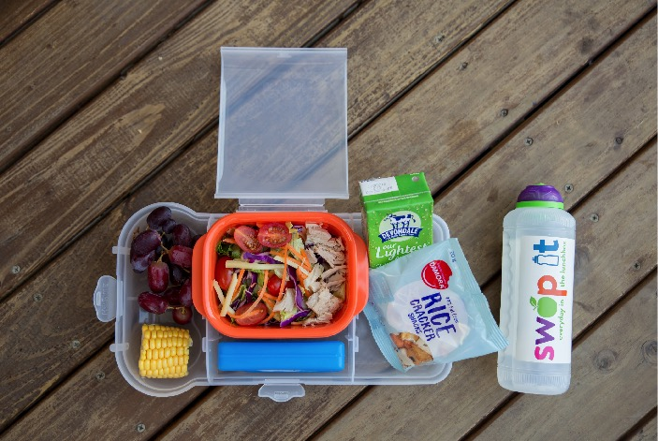
Artwork: ‘Heart of a child’ by Lara Went, Worimi Artist
Notes:
TEACHER NOTES
a. Draw attention to each item packed in the picture
b. Ask who has each item packed in their lunchbox
c. What do they like about it? Prompt for taste, texture and smell
d. Ask who thinks they will have each item in their lunchbox this week
What you might like to say if children give the following responses:
- “That’s yuck/gross/disgusting”
RESPONSE ideas -
• Everyone likes different things and it’s ok to be different. Sometimes people don’t like one type of food for a long time and then suddenly like it!
• Do you know what the food is?
• Have you tried this food before?
• Would you try the food if your friend was eating it/sports person?
• Would you try the food if it was cut into smaller pieces?
• Would you try the food if you were really hungry/time of the day?
TEACHER’S RESOURCE
https://www.eatforhealth.gov.au/food-essentials/five-food-groups/grain-cereal-foods-mostly-wholegrain-and-or-high-cereal-fibre
The 5 food groups are:
• Vegetables and legumes/beans;
• Fruit;
• Milk, yoghurt, cheese and/or alternatives;
• Lean meats and poultry, fish, eggs, tofu, nuts and seeds and legumes/beans;
• Grain (cereal) foods (this is where rice crackers fit).
Other grain (cereal) foods include: bread, breakfast cereal, pasta and rice.
Whilst brands may be depicted in these images, Good For Kids has no affiliation and do not endorse any specific food brand. We do not warrant that the information we provide will meet individual health, nutritional or medical requirements,
or individual school policy. For more lunchbox suggestions see www.goodforkids.nsw.gov.au.

Slide 8
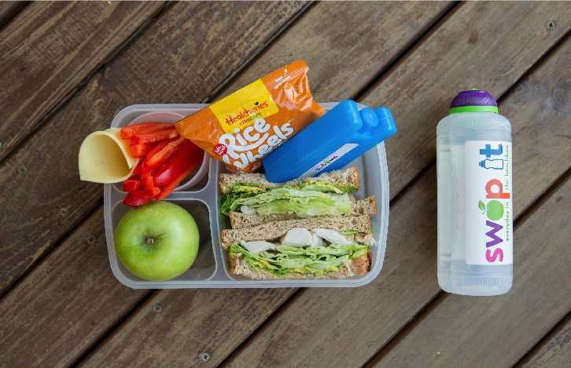
Artwork: ‘Heart of a child’ by Lara Went, Worimi Artist
Notes:
TEACHER NOTES
a. Draw attention to each item packed in the picture
b. Ask who has each item packed in their lunchbox
c. What do they like about it? Prompt for taste, texture and smell
d. Ask who thinks they will have each item in their lunchbox this week
What you might like to say if children give the following responses:
- “That’s yuck/gross/disgusting”
RESPONSE ideas -
• Everyone likes different things and it’s ok to be different. Sometimes people don’t like one type of food for a long time and then suddenly like it!
• Do you know what the food is?
• Have you tried this food before?
• Would you try the food if your friend was eating it/sports person?
• Would you try the food if it was cut into smaller pieces?
• Would you try the food if you were really hungry/time of the day?
TEACHER’S RESOURCE
https://www.eatforhealth.gov.au/food-essentials/five-food-groups/lean-meat-and-poultry-fish-eggs-tofu-nuts-and-seeds-and
The 5 food groups are:
• Vegetables and legumes/beans;
• Fruit;
• Milk, yoghurt, cheese and/or alternatives;
• Lean meats and poultry, fish, eggs, tofu, nuts and seeds and legumes/beans (this is where chicken fits);
• Grain (cereal) foods.
Other foods in this category include: beef, lamb, pork, fish, eggs, nuts and seeds, tofu, legumes/beans.
Whilst brands may be depicted in these images, Good For Kids has no affiliation and do not endorse any specific food brand. We do not warrant that the information we provide will meet individual health, nutritional or medical requirements,
or individual school policy. For more lunchbox suggestions see www.goodforkids.nsw.gov.au.

Slide 9
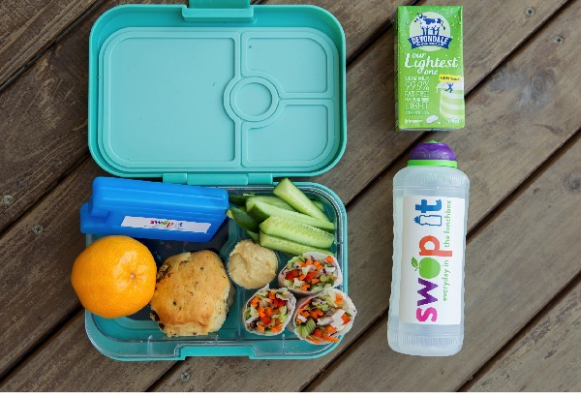
Artwork: ‘Heart of a child’ by Lara Went, Worimi Artist
Notes:
TEACHER NOTES
a. Draw attention to each item packed in the picture
b. Ask who has each item packed in their lunchbox
c. What do they like about it? Prompt for taste, texture and smell
d. Ask who thinks they will have each item in their lunchbox this week
What you might like to say if children give the following responses:
- “That’s yuck/gross/disgusting”
RESPONSE ideas -
• Everyone likes different things and it’s ok to be different. Sometimes people don’t like one type of food for a long time and then suddenly like it!
• Do you know what the food is?
• Have you tried this food before?
• Would you try the food if your friend was eating it/sports person?
• Would you try the food if it was cut into smaller pieces?
• Would you try the food if you were really hungry/time of the day?
TEACHER’S RESOURCE
https://www.healthdirect.gov.au/Vitamin-c
Other foods with Vitamin C include: blackcurrants, other citrus fruits such as oranges, limes
and lemons, berries, kiwifruit, tomatoes, broccoli, sprouts and red, yellow and green capsicums.
Whilst brands may be depicted in these images, Good For Kids has no affiliation and do not endorse any specific food brand. We do not warrant that the information we provide will meet individual health, nutritional or medical requirements,
or individual school policy. For more lunchbox suggestions see www.goodforkids.nsw.gov.au.

Slide 10
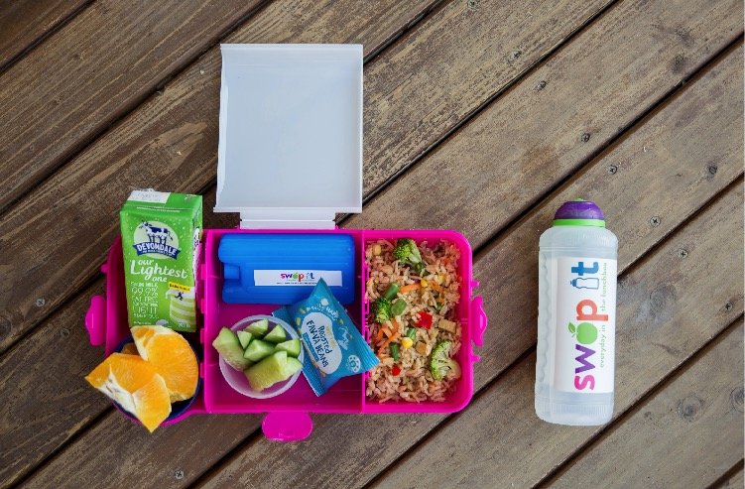
Artwork: ‘Heart of a child’ by Lara Went, Worimi Artist
Notes:
TEACHER NOTES
a. Draw attention to each item packed in the picture
b. Ask who has each item packed in their lunchbox
c. What do they like about it? Prompt for taste, texture and smell
d. Ask who thinks they will have each item in their lunchbox this week
What you might like to say if children give the following responses:
- “That’s yuck/gross/disgusting”
RESPONSE ideas -
• Everyone likes different things and it’s ok to be different. Sometimes people don’t like one type of food for a long time and then suddenly like it!
• Do you know what the food is?
• Have you tried this food before?
• Would you try the food if your friend was eating it/sports person?
• Would you try the food if it was cut into smaller pieces?
• Would you try the food if you were really hungry/time of the day?
TEACHER’S RESOURCE
http://www.kitchengardens.det.nsw.edu.au/kg/01_teachers/index.htm
Kitchen and food gardens are an increasingly popular way for schools to promote environmental and sustainability learning and connect students with healthy food and lifestyles. This website lists programs that can help.
Whilst brands may be depicted in these images, Good For Kids has no affiliation and do not endorse any specific food brand. We do not warrant that the information we provide will meet individual health, nutritional or medical requirements,
or individual school policy. For more lunchbox suggestions see www.goodforkids.nsw.gov.au.

